Slide 1
Quality Attribute Modeling and Analysis

Slide 2
Outline
Modeling Architectures to Enable Quality Attribute Analysis
Quality Attribute Checklists
Thought Experiments and Back-of-the-Envelope Analysis
Experiments, Simulations, and Prototypes
Analysis at Different Stages of the Life Cycle

Slide 3
Modeling Architectures to Enable Quality Attribute Analysis
Some quality attributes, most notably performance and availability, have well-understood, time-tested analytic models that can be used to assist in an analysis.
By analytic model, we mean one that supports quantitative analysis. Let us first consider performance.

Slide 4
Performance Models
Scheduling algorithm
arrivals
results
queue
server
Routing of messages
Parameters: arrival rate of events, chosen queuing discipline, chosen scheduling algorithm, service time for events, network topology, network bandwidth, routing algorithm chosen

Slide 5
Allocation Model for MVC

Slide 6


Queuing Model for MVC
Users Generate Requests
Model
5
3
4
View
1
2
Controller
Arrivals
View sends requests to Controller
Actions returned to View
Actions returned to model
Model sends actions to View

Slide 7
Parameters
To solve a queuing model for MVC performance, the following parameters must be known or estimated:
  The frequency of arrivals from outside the system
  The queuing discipline used at the view queue
  The time to process a message within the view
  The number and size of messages that the view sends to the controller
  The bandwidth of the network that connects the view and the controller
  The queuing discipline used by the controller
  The time to process a message within the controller
  The number and size of messages that the controller sends back to the view
  The bandwidth of the network from the controller to the view
  The number and size of messages that the controller sends to the model
  The queuing discipline used by the model
  The time to process a message within the model
  The number and size of messages the model sends to the view
  The bandwidth of the network connecting the model and the view

Slide 8
Cost/benefit of Performance Modeling
Cost: determining the parameters previously mentioned
Benefit: estimate of the latency
The more accurately the parameters can be estimated, the better the predication of latency.
This is worthwhile when latency is important and questionable.
This is not worthwhile when it is obvious there is sufficient capacity to satisfy the demand.

Slide 9
Availability Modeling
Three different tactics for increasing the availability of the broker are:
  active redundancy (hot spare)
  passive redundancy (warm spare)
  spare (cold spare).

Slide 10
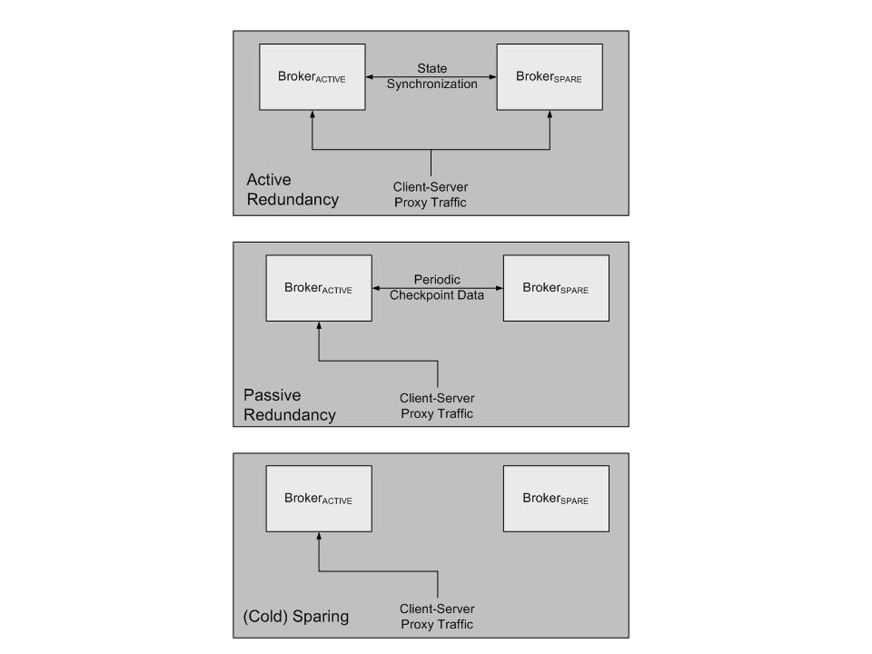
Making Broker More Available
Key:
process:
message:

Slide 11
Applying Probabilities to Tactics
Using probabilities to model different tactics
  When two events A and B are independent, the probability that A or B will occur is the sum of the probability of each event: P(A or B) = P(A)+ P(B).
  When two events A and B are independent, the probability of both occurring is P(A and B) = P(A) • P(B).
  When two events A and B are dependent, the probability of both occurring is P(A and B) = P(A) • P(B|A), where the last term means “the probability of B occurring, given that A occurs.”

Slide 12
Passive Redundancy
Assume
  failure of a component (primary or backup) is independent of the failure of its counterpart
  assume failure probability of both is the same: P(F)
Then probability that both will fail is: 1 - P(F)²
Can also estimate probability of failure given other tactics.
Then given a cost of implementing appropriate tactic we can do cost/benefit analysis

Slide 13
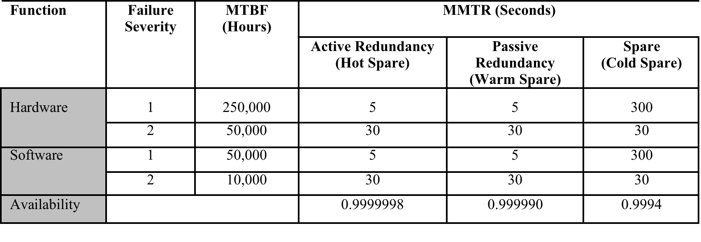
Calculated Availability for an Availability-Enhanced Broker

Slide 14
Maturity of Quality Attribute Models
Quality Attribute | Intellectual Basis | Maturity / Gaps
Availability | Markov models; Statistical models | Moderate maturity in the hardware reliability domain, less mature in the software domain. Requires models that speak to state recovery and for which failure percentages can be attributed to software.
Interoperability | Conceptual framework | Low maturity; models require substantial human interpretation and input.
Modifiability | Coupling and cohesion metrics; Cost models | Substantial research in academia; still requires more empirical support in real-world environments.
Performance | Queuing theory; Real time scheduling theory | High maturity; requires considerable education and training to use properly.
Security | No architectural models
Testability | Component Interaction Metrics | Low maturity; little empirical validation.
Usability | No architectural models

Slide 15
Quality Attribute Checklists
A quality attribute checklist provides a means of:
  Checking requirements. Do the requirements capture all of the nuances of a particular quality attribute?
  Auditing. Does the design satisfy all of the aspects necessary for a certification process.

Slide 16
Security Checklists
Security checklists are common.
  Vendors who accept credit cards should conform to the PCI (Personal Credit Information) standard
  Electricity producers have security checklists to prevent attacks on critical infrastructure
Checklists have both:
  Product requirements. E.g. the PCI checklist states that the security code on the back of the credit card should never be stored.
  Process requirements. E.g. patches should be applied promptly and there should be someone who has the organizational responsibility to ensure that they are.

Slide 17
Thought Experiments
A thought experiment is mentally or verbally working through a particular scenario.
  Commonly done by the architect during design to explore alternatives.
  Also done during evaluation/documentation to convince third parties of the wisdom of particular design choices

Slide 18
Thought Experiment Steps
Enumerate the steps of a use case
At each step, ask {yourself, the architect}
  What mechanism is being implemented to support the achievement of which particular quality requirement?
  Does this mechanism hinder the achievement of other quality attribute requirements?
Record problems for later deeper analysis or prototype building

Slide 19
Back-of-the-Envelope Analysis
Analysis does not need to be precise or detailed.
Rough analysis serves for many purposes. E.g. “the volume of traffic generated by this source should be well within the bounds handled by modern infrastructure”
Only do deeper analysis for questionable areas or important requirements.

Slide 20
Experiments, Simulations, and Prototypes
Many tools can help perform experiments to determine behavior of a design
  Request generators can create synthetic loads to test scalability
  Monitors can perform non-intrusive resource usage detection.
These depend on having a partial or prototype implementation.
  Prototype alternatives for the most important decisions
  If possible, implement prototype in a fashion so that some of it can be re-used.
  Fault injection tools can induce faults to determine response of system under failure conditions.

Slide 21
Simulations
Event based simulators exist that can be used to simulate behavior of system under various loads
  Must create the simulation.
  Must have a variety of different loads and responses to check for.

Slide 22
Analysis During Requirements and Design
Different types of analysis are done at different stages of the life cycle
Requirements:
  Analytic models/back of the envelope analysis can help capacity planning
  Checklists can help ensure capture correct set of requirements
Design:
  Prototypes can help explore design options
  Analytic models or simulation can help understand potential bottlenecks
  Checklists can help determine if used a correct mechanism

Slide 23
Analysis During Implementation or Fielding
Experiments and synthetic load tests can be used during the implementation process or after fielding
Monitors can be used after fielding to determine actual behavior and find bottlenecks.

Slide 24
Analysis at Different Stages of the Lifecycle
Life-Cycle Stage | Form of Analysis | Cost | Confidence
Requirements | Experience-based analogy | Low | Low-High
Requirements | Back-of-the-envelope | Low | Low-Medium
Architecture | Thought experiment | Low | Low-Medium
Architecture | Checklist | Low | Medium
Architecture | Analytic Model | Low-Medium | Medium
Architecture | Simulation | Medium | Medium
Architecture | Prototype | Medium | Medium-High
Implementation | Experiment | Medium-High | Medium-High
Fielded System | Instrumentation | Medium-High | High

Slide 25
Summary
Analysis is always a cost/benefit activity
  Cost is measure of creating and executing the analysis models and tools
  Benefit depends on
    Accuracy of analysis
    Importance of what is being analyzed
Analysis can be done through
  Models for some attributes
  Measurement
  Thought experiments
  Simulations
  Prototypes

